Slide 1
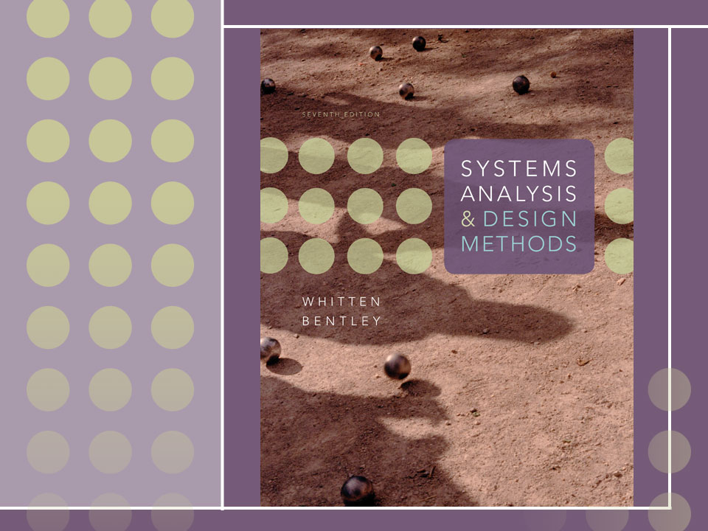
Chapter 10
Object-Oriented Analysis and Modeling Using the UML

Slide 2
Objectives
Define object modeling and explain its benefits.
Recognize and understand the basic concepts and constructs of object modeling.
Define the UML and its various types of diagrams.
Evolve a business requirements use-case model into a system analysis use-case model.
Construct an activity diagram.
Discover objects and classes, and their relationships.
Construct a class diagram.

Slide 3
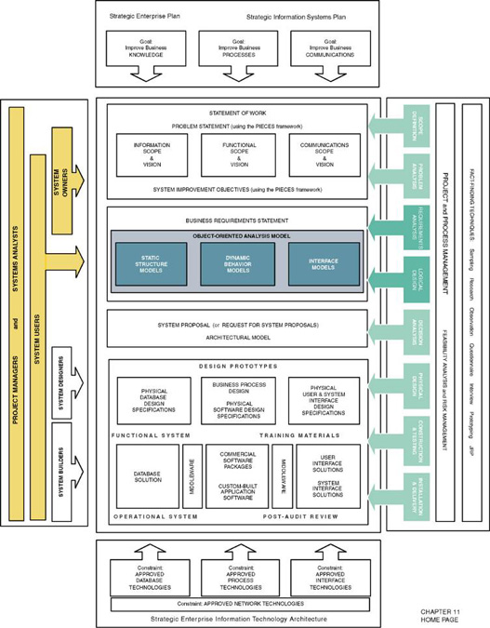

Slide 4
Introduction to Object Modeling
Object-oriented analysis (OOA) – an approach used to
  study existing objects to see if they can be reused or adapted for new uses
  define new or modified objects that will be combined with existing objects into a useful business computing application
Object modeling – a technique for identifying objects within the systems environment and the relationships between those objects.

Slide 5
Introduction to the UML
Unified Modeling Language (UML) – a set of modeling conventions that is used to specify or describe a software system in terms of objects.
    The UML does not prescribe a method for developing systems—only a notation that is now widely accepted as a standard for object modeling.

Slide 6
Objects & Attributes
Object – something that is or is capable of being seen, touched, or otherwise sensed, and about which users store data and associate behavior.
  Person, place, thing, or event
  Employee, customer, instructor, student
  Warehouse, office, building, room
  Product, vehicle, computer, videotape
Attribute – the data that represent characteristics of interest about an object.

Slide 7
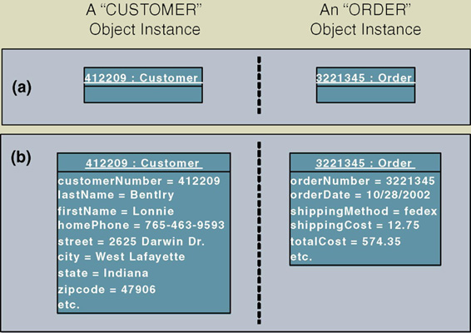
Objects & Object Instances
Object instance – each specific person, place, thing, or event, as well as the values for the attributes of that object.

Slide 8
Behavior & Encapsulation
Behavior – the set of things that the object can do that correspond to functions that act on the object’s data (or attributes).
  In object-oriented circles, an object’s behavior is commonly referred to as a method, operation, or service.
Encapsulation – the packaging of several items together into one unit.

Slide 9
Object Classes
Object Class – a set of objects that share common attributes and behavior. Sometimes referred to as a class.

Slide 10
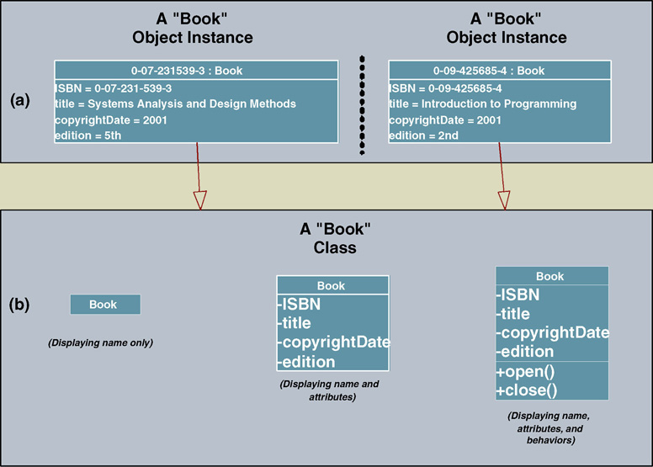
Representing Object Classes in the UML

Slide 11
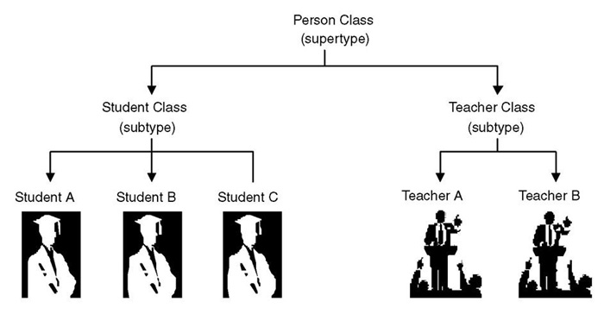
Inheritance
Inheritance – the concept wherein methods and/or attributes defined in an object class can be inherited or reused by another object class.

Slide 12
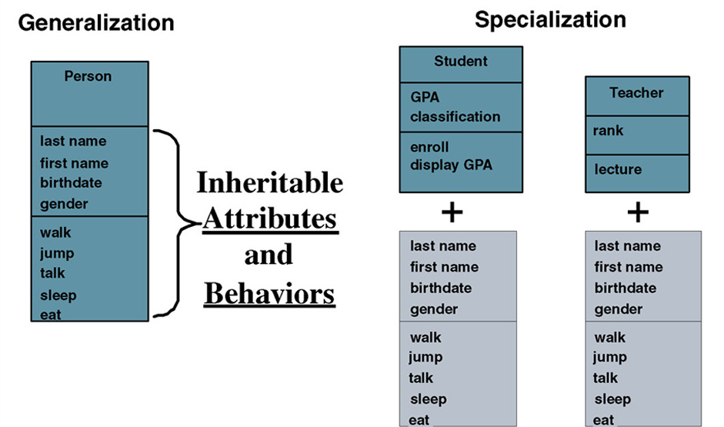
Inheritance (cont.)

Slide 13
Generalization/Specialization, Supertype, and Subtype
Generalization/specialization – technique wherein attributes and behaviors common to several types of object classes are grouped (or abstracted) into their own class, called a supertype.
Supertype – an entity that contains attributes and behaviors that are common to one or more class subtypes. Also referred to as abstract or parent class.
Subtype – an object class that inherits attributes and behaviors from a supertype class and may contain other attributes and behaviors unique to it. Also referred to as a child class and, if it exists at the lowest level of the inheritance hierarchy, as concrete class.

Slide 14
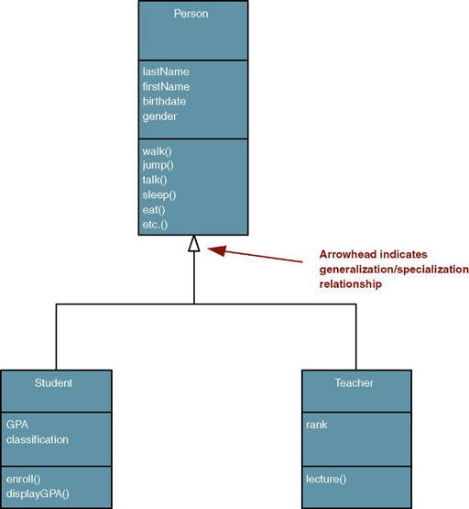
UML Representation of Generalization/Specialization

Slide 15
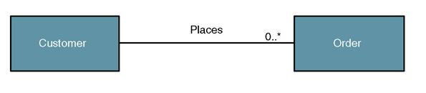
Object/Class Relationships
Object/class relationship – a natural business association that exists between one or more objects and classes.

Slide 16
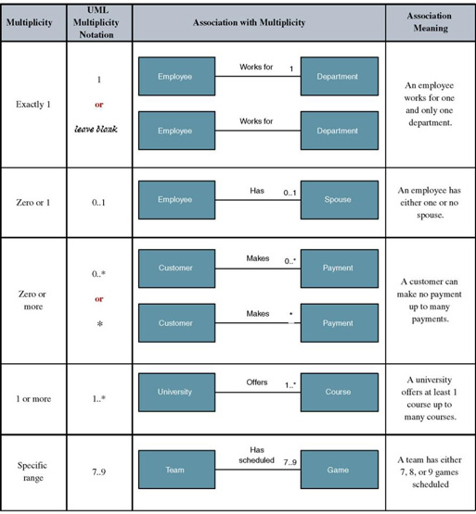
UML Multiplicity Notations
Multiplicity – the minimum and maximum number of occurrences of one object/class for a single occurrence of the related object/class.

Slide 17
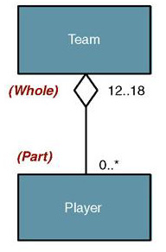
Aggregation
Aggregation – a relationship in which one larger “whole” class contains one or more smaller “parts” classes. Conversely, a smaller “part” class is part of a “whole” larger class
  In UML 2.0 the notation for aggregation has been dropped

Slide 18
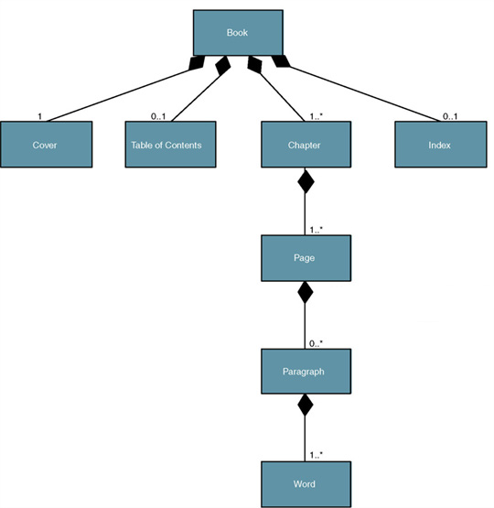
Composition
Composition – an aggregation relationship in which the “whole” is responsible for the creation and destruction of its “parts.” If the “whole” were to die, the “part” would die with it.

Slide 19
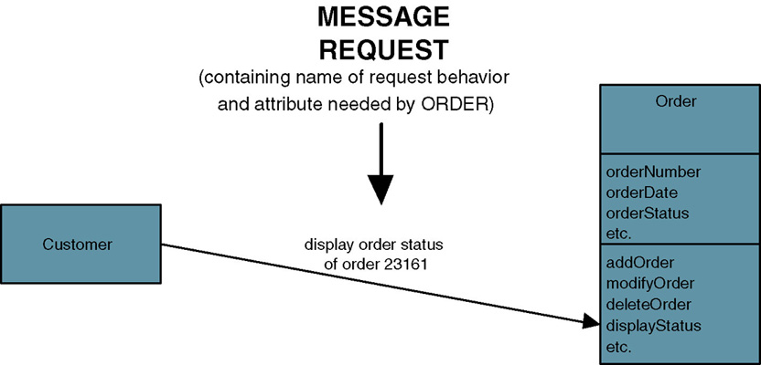
Messages
Message – communication that occurs when one object invokes another object’s method (behavior) to request information or some action

Slide 20
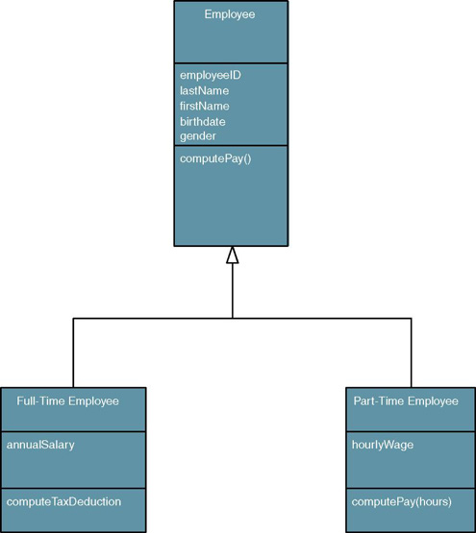
Polymorphism
Polymorphism – the concept that different objects can respond to the same message in different ways.
Override – a technique whereby a subclass (subtype) uses an attribute or behavior of its own instead of an attribute or behavior inherited from the class (supertype).

Slide 21
UML 2.0 Diagrams
Diagram | Description
Use Case | Depicts interactions between the system and external systems and users. In other words it graphically describes who will use the system and in what ways the user expects to interact with the system. The use-case narrative is used in addition to textually describe the sequence of steps of each interaction.
Activity | Depicts sequential flow of activities of a use case or business process. It can also be used to model logic with the system.
Class | Depicts the system's object structure. It shows object classes that the system is composed of as well as the relationships between those object classes.
Object | Similar to a class diagram, but instead of depicting object classes, it models actual object instances with current attribute values. The object diagram provides the developer with a "snapshot" of the system's object at one point in time.
State Machine | Models how events can change the state of an object over its lifetime, showing both the various states that an object can assume and the transitions between those states.
Composite Structure | Decomposes internal structure of class, component, or use case.

Slide 22
UML 2.0 Diagrams (cont.)
Diagram | Description
Sequence | Graphically depicts how objects interact with each other via messages in the execution of a use case or operation. It illustrates how messages are sent and received between objects and in what sequence.
Communication | (Collaboration diagram in UML 1.X) Depicts interaction of objects via messages. While a sequence diagram focuses on the timing or sequence of messages, a communication diagram focuses on the structural organization of objects in a network format.
Interaction Overview | Combines features of sequence and activity diagrams to show how objects interact within each activity of a use case.
Timing | Another interaction diagram that focuses on timing constraints in the changing state of a single object or group of objects. Especially useful when designing embedded software for devices.
Component | Depicts the organization of programming code divided into components and how the components interact.
Deployment | Depicts the configuration of software components within the physical architecture of the system's hardware "nodes."
Package | Depicts how classes or other UML constructs are organized into packages (corresponding to Java packages or C++ and .NET namespaces) and the dependencies of those packages.

Slide 23
The Process of Object Modeling
Modeling the functions of the system.
Finding and identifying the business objects.
Organizing the objects and identifying their relationships.

Slide 24
Construction the Analysis
Use-Case Model
System analysis use case – a use case that documents the interaction between the system user and the system. It is highly detailed in describing what is required but is free of most implementation details and constraints.
  Identify, define, and document new actors.
  Identify, define, and document new use cases.
  Identify any reuse possibilities.
  Refine the use-case model diagram (if necessary).
  Document system analysis use-case narratives.

Slide 25
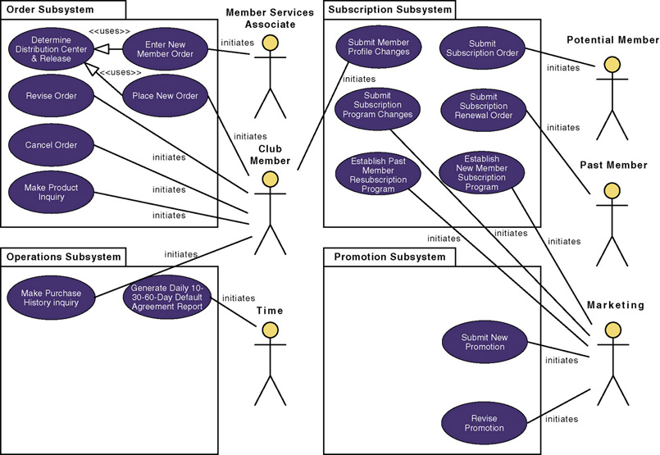
Revised System
Use-Case Model Diagram

Slide 26
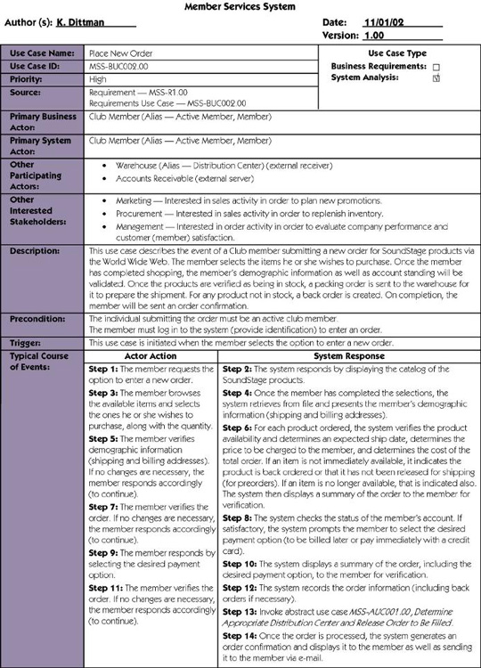
Use-Case Narrative

Slide 27
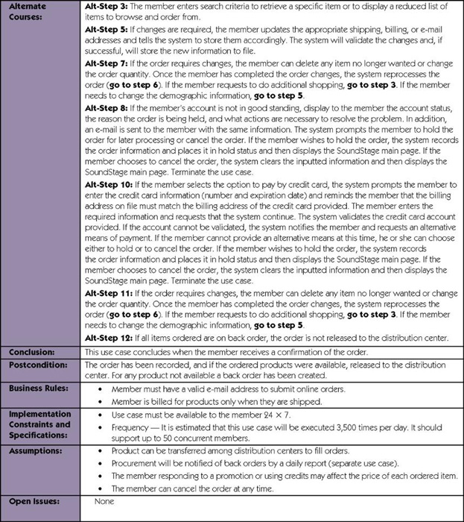
Use-Case Narrative (cont.)

Slide 28
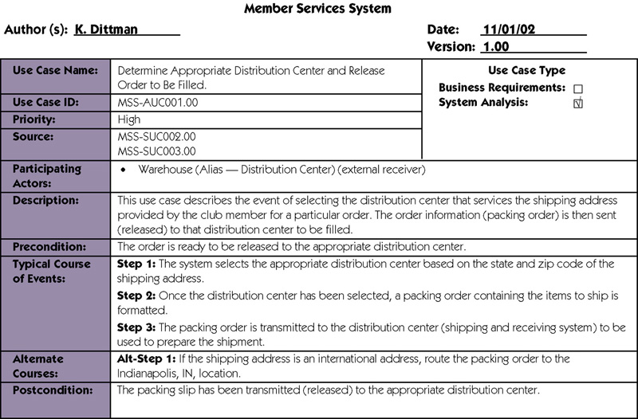
Abstract Use-Case Narrative

Slide 29
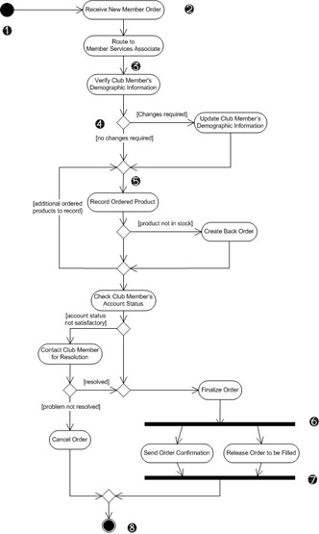
Modeling Use-Case Activities
Activity diagram – a diagram that can be used to graphically depict the flow of a business process, the steps of a use case, or the logic of an object behavior (method).

Slide 30
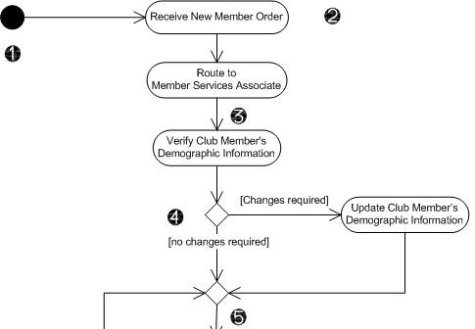
Activity Diagram Notations
Initial node - solid circle
representing the start
of the process.
Actions – rounded
rectangles representing
individual steps. The
sequence of actions
make up the total activity
shown by the diagram.
Flow - arrows on the
diagram indicating the
progression through the
actions. Most flows do not
need words to identify them unless coming out of decisions.
Decision - diamond shapes with one flow coming in and two or more flows going out. The flows coming out are marked to indicate the conditions.
Merge - diamond shapes with multiple flows coming in and one flow going out. This combines flows previously separated by decisions. Processing continues with any one flow coming into the merge.

Slide 31
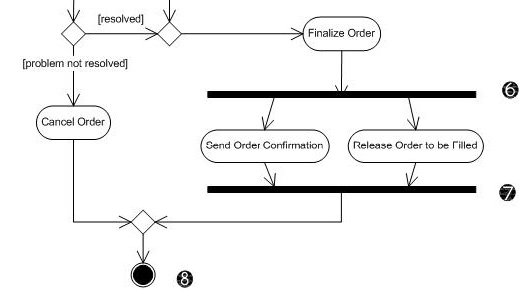
Activity Diagram Notations (cont.)
Fork – a black bar
with one flow
coming in and two
or more flows going
out. Actions on
parallel flows
beneath the fork
can occur in any
order or
concurrently.
Join – a black bar with two or more flows coming in and one flow going out, noting the end of concurrent processing. All actions coming into the join must be completed before processing continues.
Activity final – the solid circle inside the hollow circle representing the end of the process.

Slide 32
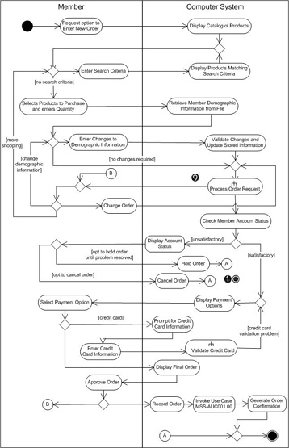
Activity Diagram with Partitions
Subactivity indicator – the rake symbol in an action indicates that this action is broken out in another separate activity diagram. This helps you keep the activity diagram from becoming overly complex.
Connector – A letter inside a circle gives you another tool for managing complexity. A flow coming into a connector jumps to the flow coming out of a connector with a matching letter.

Slide 33
Guidelines for Constructing
Activity Diagrams
Start with one initial node as a starting point.
Add partitions if it is relevant to your analysis.
Add an action for each major step of the use case (or each major step an actor initiates.
Add flows from each action to another action, a decision point, or an end point. For maximum precision of meaning, each action should have only one flow coming in and one flow going out with all forks, joins, decisions, and merges shown explicitly.
Add decisions where flows diverge with alternating routes. Be sure to bring them back together with a merge.
Add forks and joins where activities are performed in parallel.
End with a single notation for activity final.

Slide 34
Drawing System Sequence Diagrams
System sequence diagram - a diagram that depicts the interaction between an actor and the system for a use case scenario.
  helps identify high-level messages that enter and exit the system

Slide 35
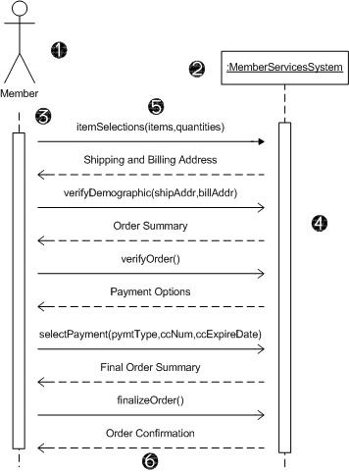
System Sequence Diagram Notations
Actor - the initiating actor of the use case is shown with the use case actor symbol.
System – the box indicates the system as a "black box" or as a whole. The colon (:) is standard sequence diagram notation to indicate a running "instance" of the system.
Lifelines – the dashed vertical lines extending downward from the actor and system symbols, which indicate the life of the sequence.
Activation bars – the bars set over the lifelines indicate period of time when participant is active in the interaction.

Slide 36
System Sequence Diagram
Notations (cont.)
Input messages - horizontal arrows from actor to system indicate the message inputs. UML convention for messages is to begin the first word with a lowercase letter and add additional words with initial uppercase letter and no space. In parentheses include parameters, following same naming convention and separated with commas.
Output messages – horizontal arrows from system to actor shown as dashed lines. Since they are web forms, reports, e-mails, etc. these messages do not need to use the standard notation.

Slide 37
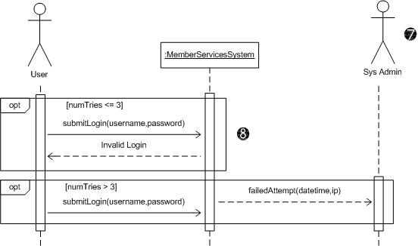
System Sequence Diagram
Notations (cont.)
Receiver Actor
– other actors or
external systems
that receive
messages from
the system can
be included.
Frame – a box
can enclose
one or more
messages to
divide off a fragment
of the sequence. These can show loops, alternate fragments, or optional (opt) steps. For an optional fragment the condition shown in square brackets indicates the conditions under which the steps will be performed.

Slide 38
Guidelines for Constructing System Sequence Diagrams
Identify which scenario of use case you will depict. Purpose is to discover messages, not to model logic. So more important to clearly communicate a single scenario.
Draw a rectangle representing the system as a whole and extend a lifeline under it.
Identify each actor who directly provides an input to the system or directly receives an output from the system. Extend lifelines under the actor(s).
Examine use case narrative to identify system inputs and outputs. Ignore messages inside system. Draw each external message as a horizontal arrow from the actor's lifeline to the system or from the system to the actor. Label inputs according to UML convention.
Add frames to indicate optional messages with conditions. Frames can also indicate loops and alternate fragments.
Confirm that the messages are shown in the proper sequence from top to bottom.

Slide 39
Finding and Identifying the Business Objects
Find the Potential Objects
  Review each use case to find nouns that correspond to business entities or events.
Select the Proposed Objects
  Not all nouns represent business objects.
    Is it a synonym of another object?
    Is it outside the scope of the system?
    Is it a role without unique behavior, or an external role?
    Is it unclear or in need of focus?
    Is it an action or an attribute that describes another object?

Slide 40
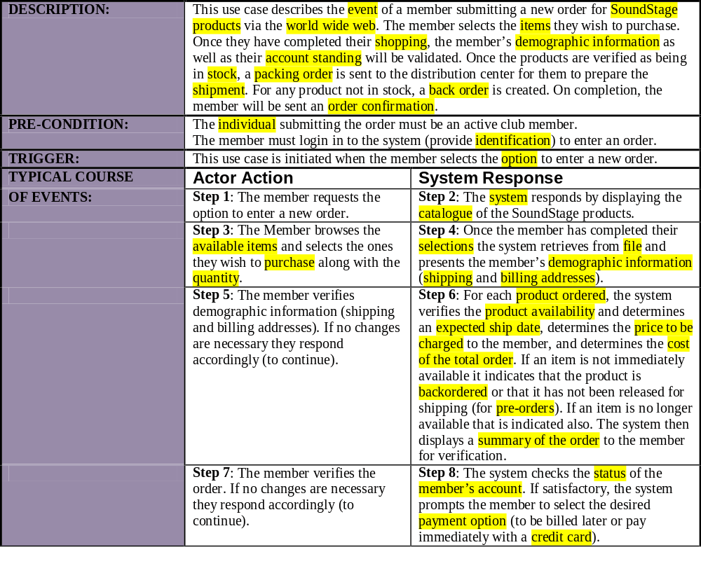
Partial Use-Case Narrative with Nouns Highlighted

Slide 41
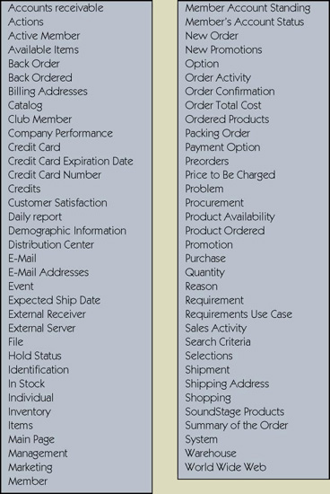
Potential Object List

Slide 42
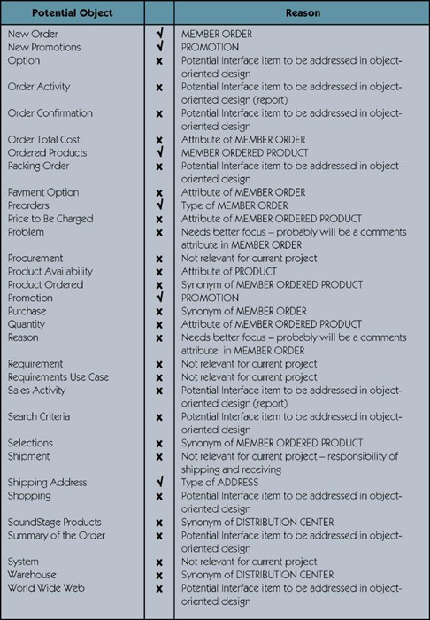
Cleaning Up List of
Candidate Objects

Slide 43
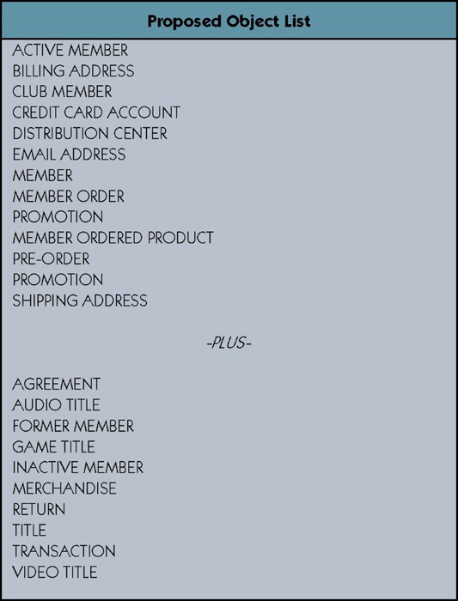
Proposed Object List

Slide 44
Organizing the Objects and Identifying their Relationships
Identifying Associations and Multiplicity
Identifying Generalization/Specialization Relationships
Identifying Aggregation Relationships
Prepare the Class Diagram
Class diagram – a graphical depiction of a system’s static object structure, showing object classes that the system is composed of as well as the relationships between those object classes.

Slide 45
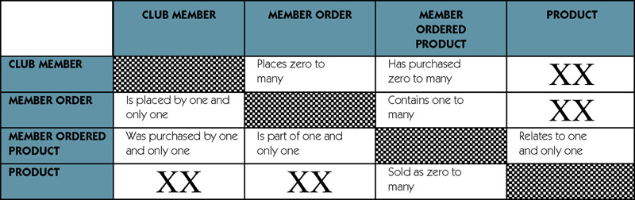
Object Association Matrix

Slide 46
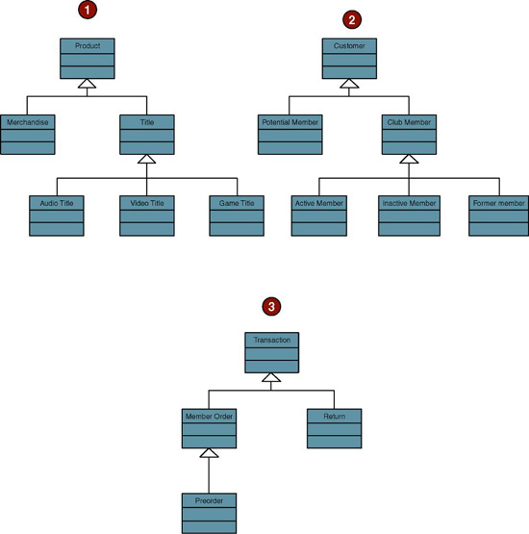
Generalization/Specialization Hierarchies

Slide 47
Persistent and Transient
Object Classes
Persistent class – a class that describes an object that outlives the execution of the program that created it.
  Stored permanently as in a database
Transient object class – a class that describes an object that is created temporarily by the program and lives only during that program’s execution.

Slide 48
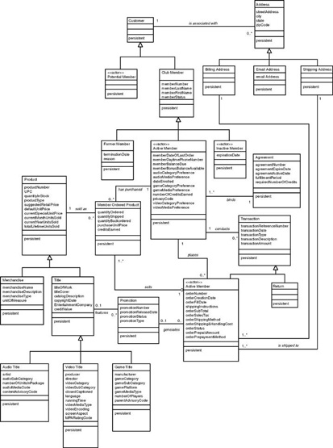
Class Diagram
Refer to Figure 10-24 in text for a more readable copy

